Slide 1
terraform {
backend "s3" {
bucket = "navs3"
key = "key/terraform.tfstate"
region = "ap-northeast-1"
dynamodb_table = "navintable"
}
}
provider "aws" {
region = "ap-northeast-1"
}
variable "ami_image_name" {
default = "ami-023ff3d4ab11b2525" #Choose a valid AMI image according to the region and operating system you wish to deploy
type = string
description = "This is a variable for AMI image"
}
variable "instance_type" {
type = string
description = "This is a variable for Instance type"
}
resource "aws_instance" "web_server" {
ami = var.ami_image_name
instance_type = var.instance_type
tags = {
"Name" = "myWebServer"
}
}
Code

Slide 2
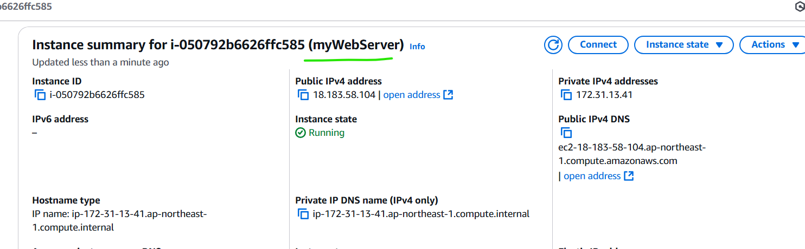
Output – instance created

Slide 3
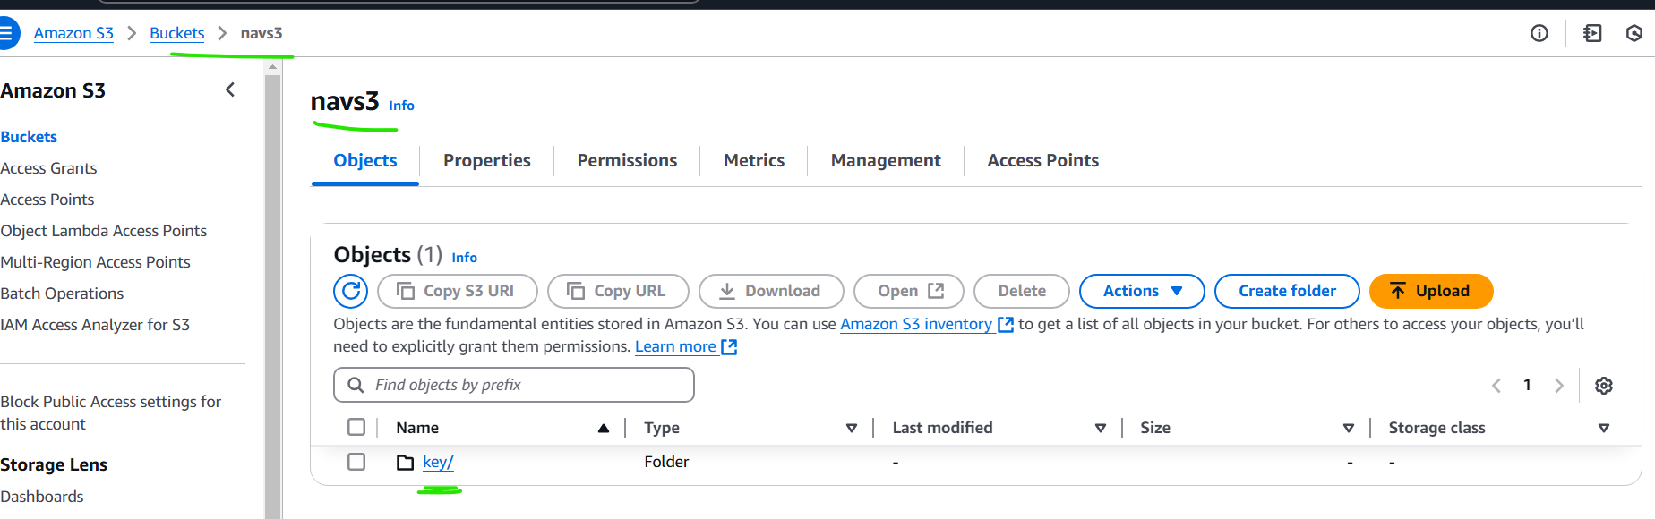
Output – key folder create in s3 bucket

Slide 4
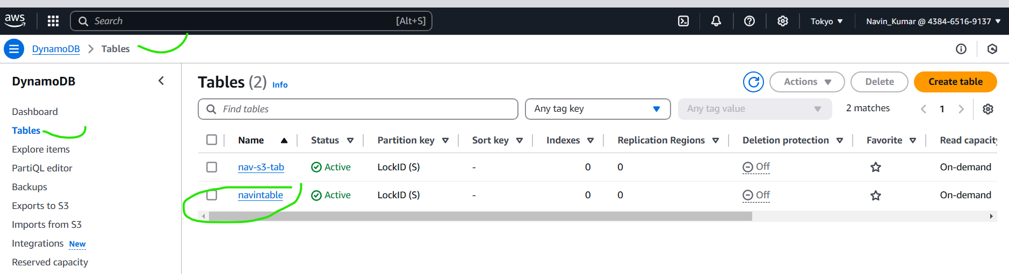
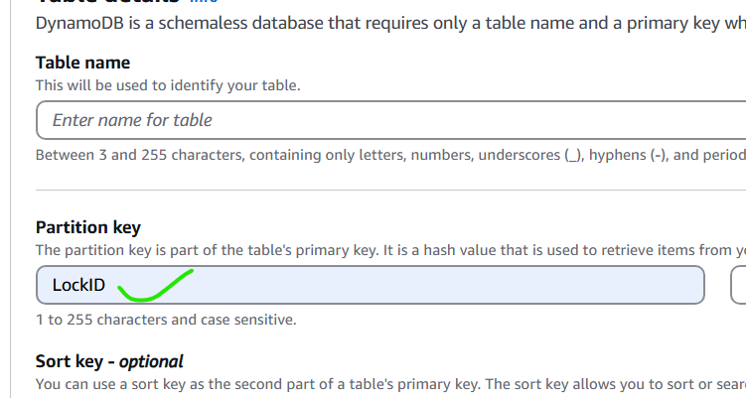
Inputs to create dynamo db

Slide 5
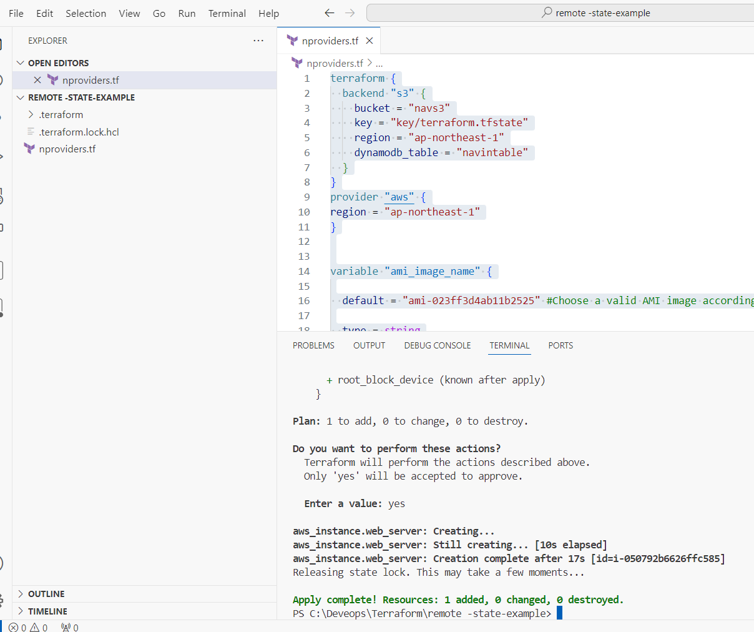
Code output

